Slide 1
Protons in IOTA Ring
Eric Prebys, Fermilab APC

Slide 2
Motivation
The primary motivation for nonlinear integrable optics is to reduce the sensitivity to harmonic instabilities and thereby enable stable beams with higher space charge or beam-beam tune shifts.
This cannot be directly measured with the electron beam.
electron beam must be used as pencil beam to probe tune space.
Eventually, we can experiment with space charge compensation techniques (e-lens, etc)
DOE review recognized this as a high priority
“…the high priority R&D goal for Fermilab is to develop the standalone IOTA ring, including its proton source. A revised cost estimate that includes these additional items [injection, instrumentation, experiments] should be provided…prior to finalizing a funding decision.”

Slide 3
Where to get protons
Luckily, we have an extra RFQ just lying around…
The HINS (“High Intensity Neutrino Source”) was developed as the front end of a pulsed “Project X” 8 GeV proton linac
Because of cooling problems, it never reached its design pulse rate
ProjectX (now PIP-II) specification was changed to a CW front end
HINS->PXIE
HINS RFQ available for our use

Slide 4
RFQ Design and Specifications
Pulsed 4-vane RFQ:

Slide 5
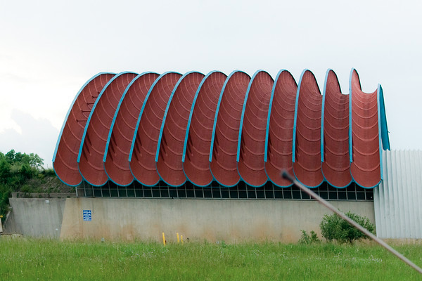
HINS Layout (During Operation)
Meson Hall
Spoke resonators will not be needed for acceleration (maybe debuncher)_

Slide 6
Rate Limitation
HINS was designed to operate at a 1% duty factor
Large tune shifts were seen at the .1% level (~Hz x ~mA)
A design flaw caused water leaks at ~30 cooling channel couplings within the RFQ, such that vacuum could not be maintained
-> No cooling
Increased temperature resulted in the observed tune shifts.
Bad for them, but no problem for us.
As the RFQ heats up, this flange bulges, causing a parasitic mode to mix and shift the resonant frequency

Slide 7
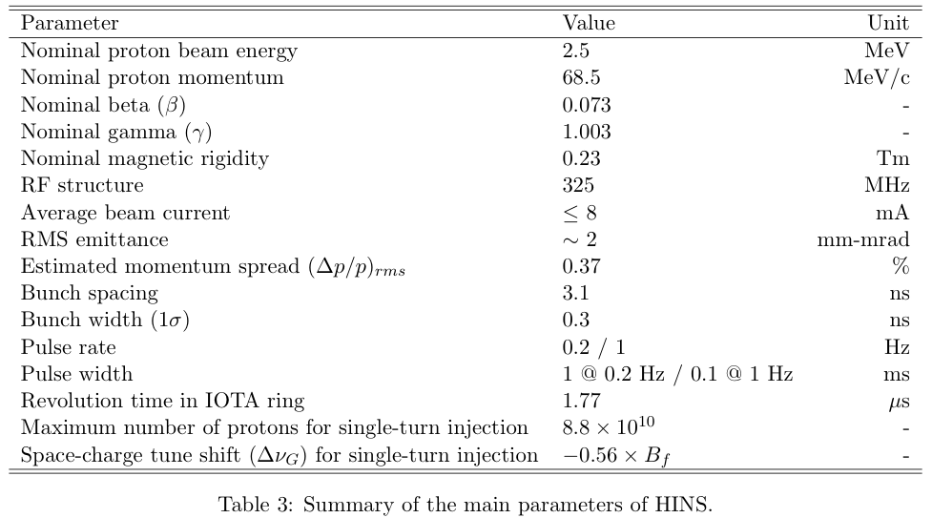
HINS Parameters
matched to IOTA momentum, but β=.073!
Big. Will probably need debuncher (not yet costed)
Why no one will steal this RFQ from us

Slide 8
Single Pulse Performance*
Aside from the rate problems, the RFQ met specifications:
Initial diagnostic configuration
Bunching efficiency
unnormalized emittance ~2 π-mm-mrad
V. Scarpine, et al

Slide 9
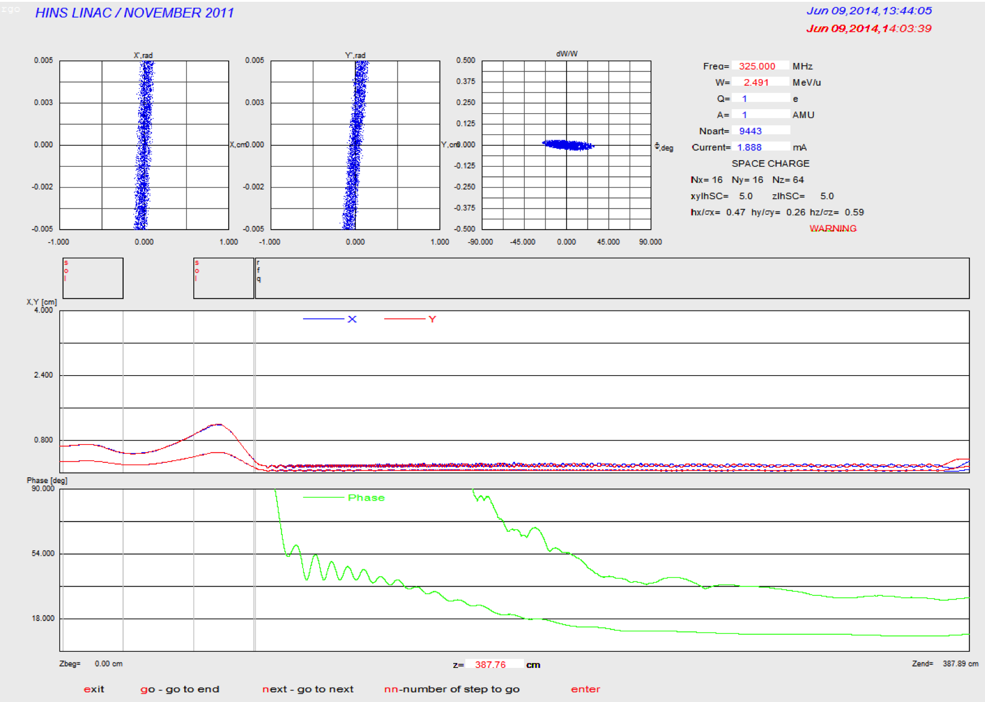
Performance well modeled
TRACK*
*J-P Carniero

Slide 10
Injection Plan
Proton injection will initially be done with a single turn, using the same kicker and lambertson as electron injection
Sufficient Aperture
Kicker pulse must be variable width
Possible upgrade to ion injection later
Note: dipole supplies unipolar
Must physically switch polarity to operate in proton mode!
Switch dipole:
OFF=electrons ON=protons

Slide 11
Design Issues
Matching: no problems foreseen
Dispersion suppression (these quads not in current design)
May need to add debuncher to reduce energy spread

Slide 12
Achromatic Dogleg
First pass with original (15°) injection line
Note: new design has shorter line/larger bend
Might be challenging to make it achromatic

Slide 13
Modified Injection
In the most recent version of the IOTA design, the injection angle has been increased, and the transfer line shortened
Still need to address this

Slide 14
Taking stock of what we have and what we haven’t
A lot of miscellaneous hardware will be reused by the PXIE program
A lot of stuff disappeared from the HINS hall between my first and second visit
We believe we have an “understanding” now.
PXIE might be finished before we need the stuff, but we’re not counting on that.
What we have
Klystron and all supporting hardware
Re-circulator, hybrid, other misc. RF hardware
RFQ
Proton source (sans 50 kV supply)
Support girder
quads (assuming we can borrow them again
What we haven’t
50 kV supply for proton source
Vacuum lines and pumps (picked clean by vultures)
Coax from upstream gallery to RFQ

Slide 15
Challenge: RFQs need lots of stuff
R. Webber
Not shown: charging supply (big). Where can we put this stuff?

Slide 16
Location of RFQ Supply Hardware
Original (bad) idea: Put all the hardware inside the IOTA ring
Might be able to make it work, but lots of problems
Interference with magnet power supplies
Placement and access
etc.
Luckily, the elimination of the second two cryomodules leaves room in the upstream ASTA gallery…

Slide 17
New Layout
Put all high power RF hardware in the upstream gallery and run coax to the RFQ itself
Planning to move equipment from the HINS test area, but may be able to reduce cost by
Using the unused charging supply->pulse transformer chain for CM 2 and 3
Using extra 325 MHz klystron currently in storage
source, RFQ and injection girder
Charging supply,modulator, pulse transformer, and klystron

Slide 18
Cost Estimate
As requested at the last review
Assume installation over two years
Item | unit cost | FY16 qty | FY17 Qty | FY16 total | FY17 total | Total
3" coax | $50 | 200 |  | 10,000 | 0 | 10,000
3" hardware |  |  |  | 2,500 | 0 | 2,500
heliac | 3 | 600 |  | 1,800 | 0 | 1,800
heliac hardware |  |  |  | 180 | 0 | 180
50 kV ion system | 79000 |  | 1 | 0 | 79,000 | 79,000
RFQ vacuum | 200000 | 1 |  | 200,000 | 0 | 200,000
misc. vacuum | 50000 |  | 1 | 0 | 50,000 | 50,000
Hydrogen system | 20000 |  | 1 | 0 | 20,000 | 20,000
Misc. cabling | 150000 | 0.5 | 0.5 | 75,000 | 75,000 | 150,000
controls/interlocks | 20000 | 0.5 | 0.5 | 10,000 | 10,000 | 20,000
Installation costs | 100000 | 0.5 | 0.5 | 50,000 | 50,000 | 100,000
T&M Electrical | 100000 | 0.5 | 0.5 | 50,000 | 50,000 | 100,000
T&M piping | 50000 | 0.5 | 0.5 | 25,000 | 25,000 | 50,000
 |  |  |  | 424,480 | 359,000 | 783,480
 |  |  | 23.5% overhead | 99,753 | 84,365 | 184,118
 |  |  |  | 524,233 | 443,365 | 967,598
Contingency |  |  |  | 157,270 | 133,010 | 290,279
Total: |  |  |  | 681,503 | 576,375 | 1,257,877

Slide 19
Possible Future Upgrade: H- injection
Install a stripping foil in the 30° bend?
Still investigating bump configuration
Not currently scoped.

Slide 20
To Do
Model proton beam in IOTA ring
Integrate proton transfer line design into overall injection design
Finalize details regarding which hardware will be used.
Move HINS klystron support gear or use extras for 1.3 GHz?
Move klystron or use spare?

